Slide 1
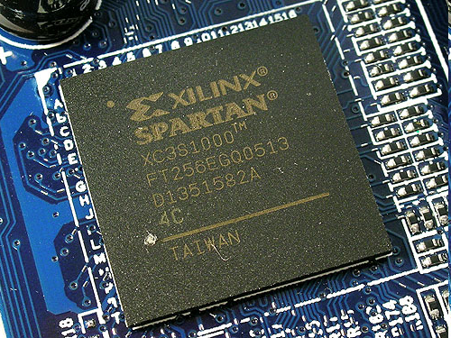
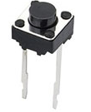
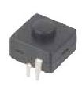
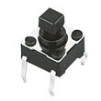

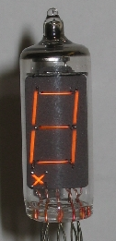
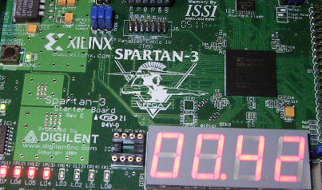
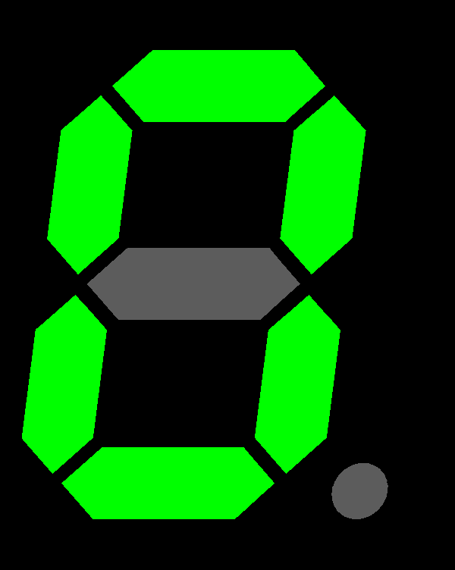
Nabil Chouba
Nabil.chouba@gmail.com
http://nabil.chouba.googlepages.com
Count & display on seven segment displayer

Slide 2
Plan
Count display spec
Main idea
Seven segment bridge block
Counter block
Display Unit – Ten block
De-bounce block
Top level block
Testbench & simulation
Synthesis result

Slide 3
Plan
Count display spec
Main idea
Seven segment bridge block
Counter block
Display Unit – Ten block
De-bounce block
Top level block
Testbench & simulation
Synthesis result

Slide 4
Count display spec
Counter value is displayed using 2 seven segment displayer
Increment counter value when switch is pushed
Simulation
Syntheses on Spartan3-1500
Implementation on FPGA board

Slide 5
Plan
Count display spec
Main idea
Seven segment bridge block
Counter block
Display Unit – Ten block
De-bounce block
Top level block
Testbench & simulation
Synthesis result

Slide 6
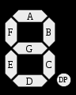
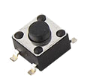
Main idea
bridge
bridge
debounce
counter
counter
display_Ten
display_unit
top
display_ten_unit
schematic block

Slide 7
Plan
Count display spec
Main idea
Seven segment bridge block
Counter block
Display Unit – Ten block
De-bounce block
Top level block
Testbench & simulation
Synthesis result

Slide 8
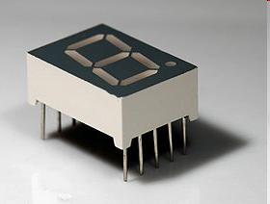
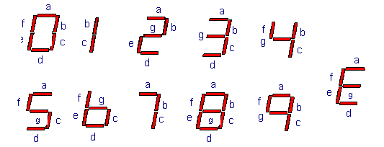
7 segment values

Slide 9
bridge coder
value | binary |  |  |  |  | a | b | c | d | e | f | g
0 | 0 | 0 | 0 | 0 |  | 1 | 1 | 1 | 1 | 1 | 1 | 0
1 | 0 | 0 | 0 | 1 |  | 0 | 1 | 1 | 0 | 0 | 0 | 0
2 | 0 | 0 | 1 | 0 |  | 1 | 1 | 0 | 1 | 1 | 0 | 1
3 | 0 | 0 | 1 | 1 |  | 1 | 1 | 1 | 1 | 0 | 0 | 1
4 | 0 | 1 | 0 | 0 |  | 0 | 1 | 1 | 0 | 0 | 1 | 1
5 | 0 | 1 | 0 | 1 |  | 1 | 0 | 1 | 1 | 0 | 1 | 1
6 | 0 | 1 | 1 | 0 |  | 1 | 0 | 1 | 1 | 1 | 1 | 1
7 | 0 | 1 | 1 | 1 |  | 1 | 1 | 1 | 0 | 0 | 0 | 0
8 | 1 | 0 | 0 | 0 |  | 1 | 1 | 1 | 1 | 1 | 1 | 1
9 | 1 | 0 | 0 | 1 |  | 1 | 1 | 1 | 1 | 0 | 1 | 1
E |  |  |  |  |  | 1 | 0 | 0 | 1 | 1 | 1 | 1

Slide 10
In/Out pin description
D
decoder7s
S7Display
Pin description:
D : 4 bits data
S7Display : 7 bits for the seven segment displayer
that code D signal

Slide 11
VHDL code
LIBRARY IEEE;
USE IEEE.STD_LOGIC_1164.ALL;
ENTITY decoder7s IS
PORT ( D :IN STD_LOGIC_VECTOR(3 DOWNTO 0);
S7Display :OUT STD_LOGIC_VECTOR(6 DOWNTO 0));
END decoder7s;
ARCHITECTURE RTL OF decoder7s IS
BEGIN
PROCESS (D)
BEGIN
CASE D IS --GFEDCBA-- (0:OFF - 1:ON)
WHEN "0000"=>
S7Display <="0111111"; -- Display 0
WHEN "0001"=>
S7Display <="0000110"; -- Display 1
WHEN "0010"=>
S7Display <="1011011"; -- Display 2
WHEN "0011"=>
S7Display <="1001111"; -- Display 3
WHEN "0100"=>
S7Display <="1100110"; -- Display 4
WHEN "0101"=>
S7Display <="1101101"; -- Display 5
WHEN "0110"=>
S7Display <="1111100"; -- Display 6
WHEN "0111"=>
S7Display <="0000111"; -- Display 7
WHEN "1000"=>
S7Display <="1111111"; -- Display 8
WHEN "1001"=>
S7Display <="1100111"; -- Display 9
WHEN OTHERS=>
S7Display <="1111001"; -- Display E : Error
END CASE;
END PROCESS;
END RTL;

Slide 12
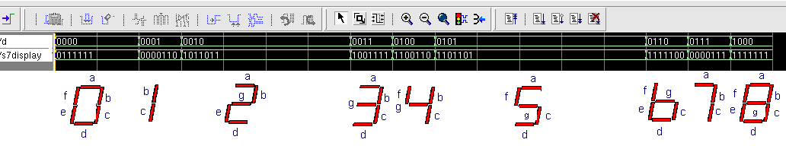
Simulation (cadence)

Slide 13
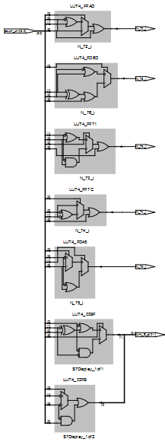
Synthesis Gate view (synplify)
Bridge 7s ten

Slide 14
Plan
Count display spec
Main idea
Seven segment bridge block
Counter block
Display Unit – Ten block
De-bounce block
Top level block
Testbench & simulation
Synthesis result

Slide 15
In/Out pin description
clk
rst
Inc
rst_count
counter
count
Pin description:
clk : clock system
rst : reset system
inc : increment the value of the counter
rst_count : allow the reset of the counter
count : count value

Slide 16
VHDL code
library ieee ;
use ieee.std_logic_1164.all ;
use ieee.std_logic_arith.all;
use ieee.std_logic_signed.all;
ENTITY counter IS
PORT ( clk : in std_logic ; -- System Clock
rst : in std_logic ; -- System Reset
inc : in std_logic ; -- count <= count + 1
rst_count : in std_logic ; -- Reset the conter count <= 0
count : OUT unsigned(3 DOWNTO 0));
END counter;
ARCHITECTURE RTL OF counter IS
signal count_reg : unsigned(3 downto 0) ;
signal count_next : unsigned(3 downto 0) ;

Slide 17
VHDL code
BEGIN
COUNTER_GEN : process
( inc,count_reg,rst_count )
begin
count_next <= count_reg;
if ( rst_count ='1' ) then
count_next <= (others=>'0');
elsif( inc ='1' ) then
count_next <= count_reg + 1 ;
end if ;
end process ;
cloked_process : process( clk, rst )
begin
if( rst='1' ) then
count_reg <= (others=>'0') ;
elsif( clk'event and clk='1' ) then
count_reg <= count_next;
end if;
end process ;
count <= count_reg;
END RTL;

Slide 18
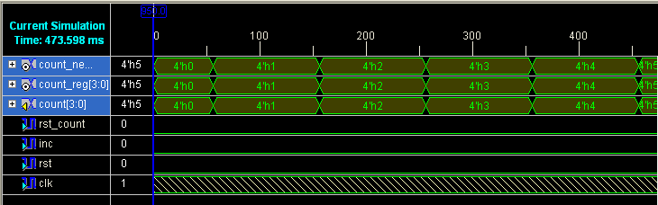
Simulation

Slide 19
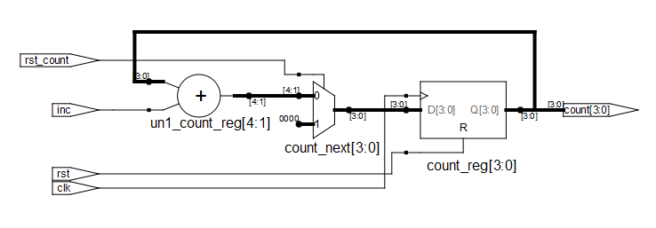
Synthesis RTL view (synplify)
Counter

Slide 20
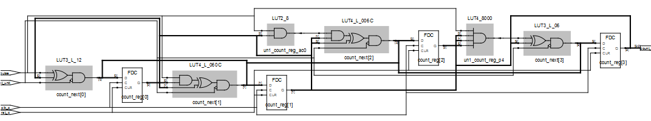
Synthesis RTL view (synplify)
Counter

Slide 21
Plan
Count display spec
Main idea
Seven segment bridge block
Counter block
Display Unit – Ten block
De-bounce block
Top level block
Testbench & simulation
Synthesis result

Slide 22
Display Unit – Ten
bridge
bridge
counter
counter
display_Ten
display_unit
display_ten_unit

Slide 23
In/Out pin description
Display_7s_ten
Display_7s_unit
clk
rst
inc
display_UnitTen
Pin description:
clk : clock system
rst : reset system
inc : increment the value
display_7s_ten : ten (of the value)
display_7s_unit : unit (of the value)

Slide 24
VHDL code
entity display_UnitTen is
port( clk : in std_logic ;
rst : in std_logic ;
inc : in std_logic ;
Display_7s_ten : out std_logic_vector(6 downto 0) ;
Display_7s_unit : out std_logic_vector(6 downto 0)
);
end display_UnitTen ;

Slide 25
VHDL code
architecture RTL of display_UnitTen is
component decoder7s IS
PORT ( D : IN STD_LOGIC_VECTOR(3 DOWNTO 0);
S7Display : OUT STD_LOGIC_VECTOR(6 DOWNTO 0)
) ;
END component;
component counter IS
PORT ( clk : in std_logic ; -- System Clock
rst : in std_logic ; -- System Reset
inc : in std_logic ; -- count <= count + 1
rst_count : in std_logic ; -- Reset the conter count <= 0
count : OUT unsigned(3 DOWNTO 0)
);
END component;
signal inc_unit : std_logic ;
signal rst_count_unit : std_logic ;
signal count_unit : unsigned(3 downto 0);
signal inc_ten : std_logic ;
signal rst_count_ten : std_logic ;
signal count_ten : unsigned(3 downto 0);

Slide 26
VHDL code
counter_unit : counter
port map ( clk => clk,
rst => rst,
inc => inc_unit,
rst_count => rst_count_unit,
count =>count_unit);
display7s_unit : decoder7s
port map (
D => STD_LOGIC_VECTOR(count_unit),
S7Display => Display_7s_unit);
counter_ten : counter
port map ( clk => clk,
rst => rst,
inc => inc_ten,
rst_count => rst_count_ten,
count => count_ten );
display7s_ten : decoder7s
port map (
D => STD_LOGIC_VECTOR(count_ten),
S7Display => Display_7s_ten);

Slide 27
VHDL code
--contorle signal for unit counter
inc_unit <= inc;
rst_count_unit <= '1' when (count_unit = 10) else
'0';
--contorle signal for ten counter
inc_ten <= '1' when (count_unit = 10) else
'0';
rst_count_ten <= '1' when (count_ten = 10) else
'0';

Slide 28
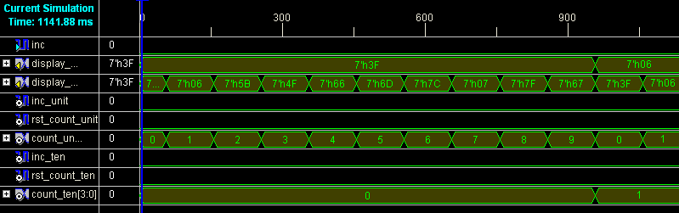
Simulation

Slide 29
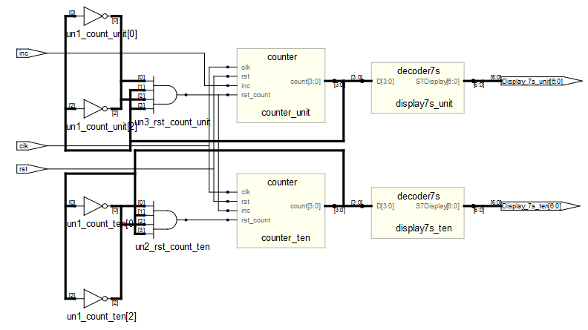
Synthesis RTL view (synplify)

Slide 30
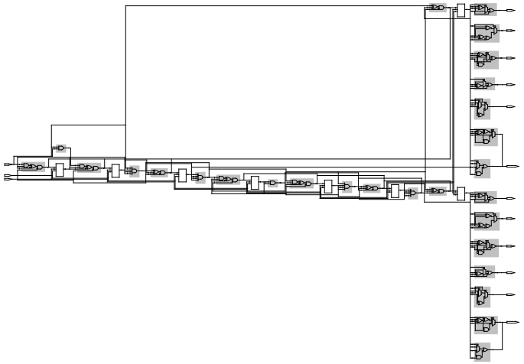
Synthesis Gate view (synplify)
Bridge 7s Unit
Counter Unit
Counter Ten
Bridge 7s ten

Slide 31
Plan
Count display spec
Main idea
Seven segment bridge block
Counter block
Display Unit – Ten block
De-bounce block
Top level block
Testbench & simulation
Synthesis result

Slide 32
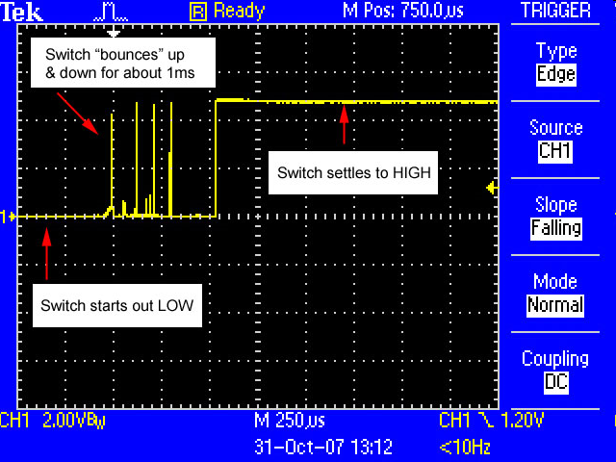
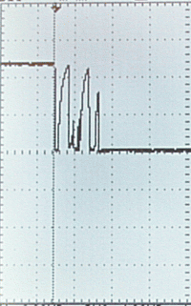
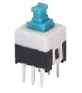
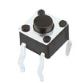
Switch & Real live !!!

Slide 33
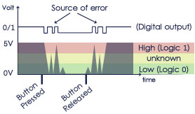
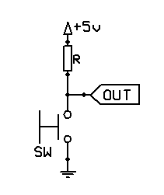
de-bouncing or filtering
Problem : due to the mechanical nature of any switch.
No clean transition from a state to another, but instead there will be a series of high and low states spikes

Slide 34
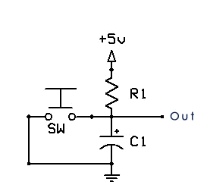
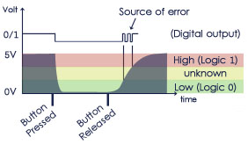
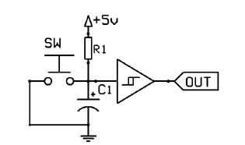
de-bouncing or filtering
Add capacitor
Voltages rise smooth and clean as compared to the previous slide
Add Schmitt Trigger,
He will keep its outputs unchanged during the passage through the 'unknown' zone,

Slide 35
State Machine : FSM
idle
Count_filter_full
push=1
wait_released
push=0
wait_count
push=1
push=0
wait_released_noise
Count_filter_full
inc_dispaly

Slide 36
VHDL code
signal count_full : std_logic ;
signal push_reg , push_next : std_logic_vector(15 downto 0) ;
signal push : std_logic ;
-- FSM States
type state_type is (idle,wait_count,inc_dispaly,wait_released_noise,wait_released);
-- FSM registers
signal state_reg : state_type;
signal state_next: state_type;
…………………………
…………………………
cloked_process : process( clk, rst )
begin
if( rst='1' ) then
push_reg <= (others =>'0') ;
state_reg <= idle ;
elsif( clk'event and clk='1' ) then
push_reg <= push_next;
state_reg<= state_next ;
end if;
end process ;

Slide 37
VHDL code
push <= '1' when state_reg = inc_dispaly else
'0';
count_full <= '1' when push_reg = "1111111111111111" else
'0';
enable <= '1';
COUNTER_GEN : process( state_reg,push_reg )
begin
push_next <= (others=>'0');
if( state_reg = wait_count or state_reg = wait_released ) then
push_next <= push_reg + 1 ;
end if ;
end process ;

Slide 38
VHDL code
--next state processing
combinatory_FSM_next :process(state_reg, red,count_full)
begin
state_next<= state_reg;
case state_reg is
when idle =>
if red = '1' then
state_next <= wait_count;
end if;
when wait_count =>
if count_full = '1' then
state_next <= inc_dispaly;
end if;
when inc_dispaly =>
state_next <= wait_released_noise;
when wait_released_noise =>
if red = '0' then
state_next <= wait_released;
end if;
when wait_released =>
if red = '1' then
state_next <= wait_released_noise;
elsif count_full = '1' then
state_next <= idle;
end if;
when others =>
end case;
end process;

Slide 39
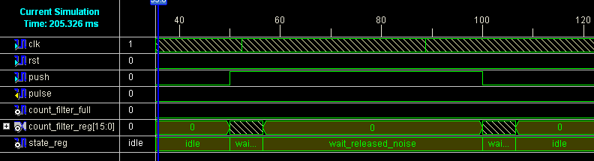
Simulation (Xilinx)

Slide 40
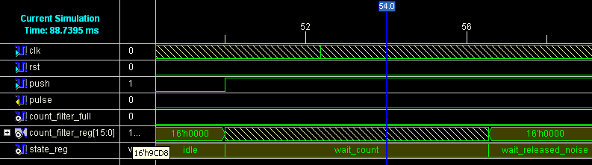
Simulation (Xilinx)

Slide 41
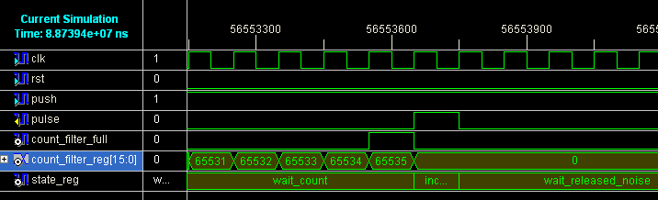
Simulation (Xilinx)

Slide 42
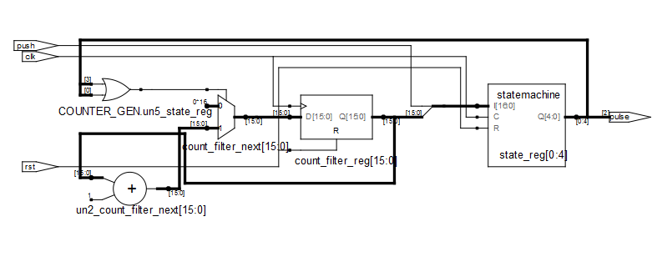
Synthesis RTL view (synplify)
De-bounce Counter
FSM pluse

Slide 43
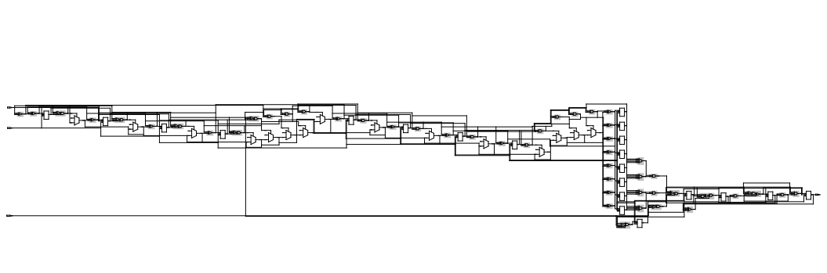
Synthesis Gate view (synplify)
De-bounce Counter
FSM pluse

Slide 44
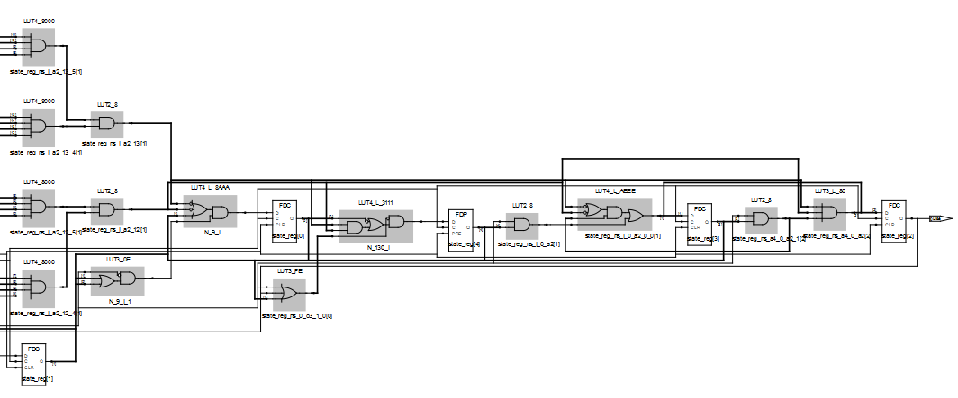
Part of Synthesis Gate view (synplify)
FSM pluse

Slide 45
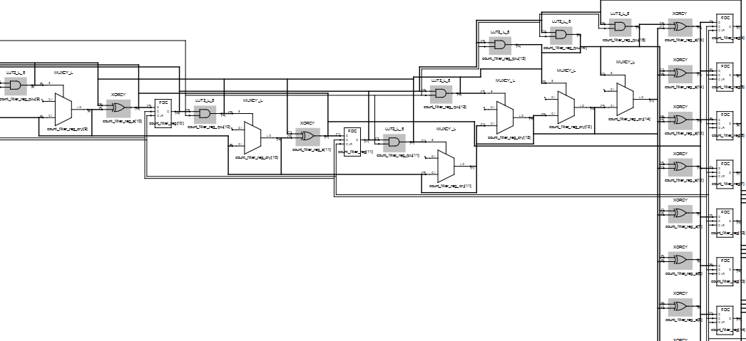
Part of Synthesis Gate view (synplify)
De-bounce Counter

Slide 46
Plan
Count display spec
Main idea
Seven segment bridge block
Counter block
Display Unit – Ten block
De-bounce block
Top level block
Testbench & simulation
Synthesis result

Slide 47
Top level
entity top is port( clk : in std_logic ;
rst : in std_logic ;
push : in std_logic ;
Unit_R : out std_logic_vector(6 downto 0) ;
Ten_R : out std_logic_vector(6 downto 0) );
end top ;
...
U_Upluse : Upluse
port map ( clk => clk,
rst => rst,
push => push,
pulse => pulse );
display_UnitTen_R : display_UnitTen
port map ( clk => clk,
rst => rst,
inc => pulse,
Display_7s_unit => Unit_R,
Display_7s_ten => Ten_R );

Slide 48
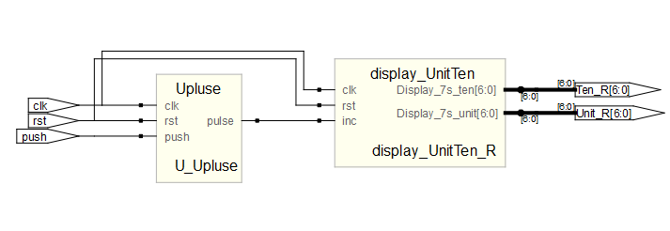
Synthesis RTL view (synplify)

Slide 49
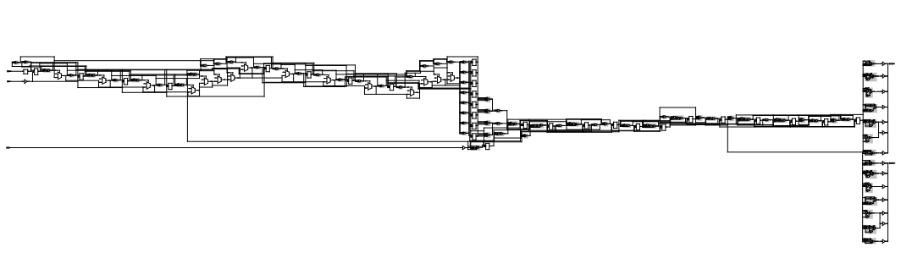
Synthesis Gate view (synplify)
De-bounce Counter
FSM pluse
Couter unit/ten
bridge 7s

Slide 50
Plan
Count display spec
Main idea
Seven segment bridge block
Counter block
Display Unit – Ten block
De-bounce block
Top level block
Testbench & simulation
Synthesis result

Slide 51
Testbench
Testbench
Behavioral Level
Design
RTL Level
(top)
-- Instantiate the Unit Under Test (UUT)
uut: top PORT MAP(
clk => clk,
rst => rst,
push => push,
Unit_R => Unit_R,
Ten_R => Ten_R );
-- signal generation
clk <= not clk after 50 ns;
rst <= '0' after 150 ns;
push <= not push after 50 ms;

Slide 52
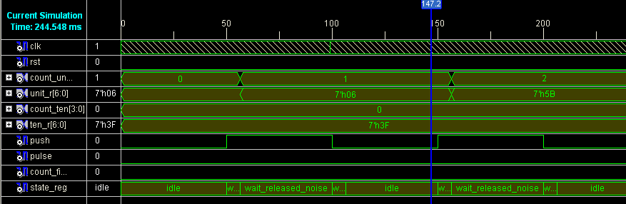
Simulation (Xilinx)

Slide 53
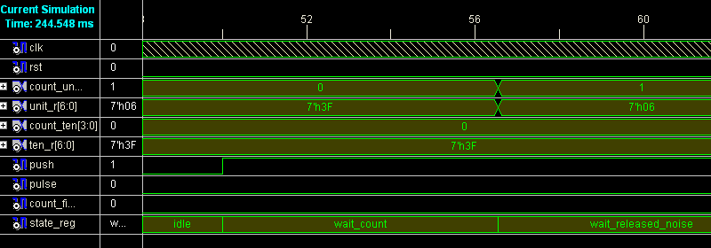
Simulation (Xilinx)

Slide 54
Plan
Count display spec
Main idea
Seven segment bridge block
Counter block
Display Unit – Ten block
De-bounce block
Top level block
Testbench & simulation
Synthesis result

Slide 55
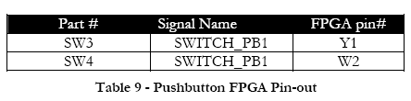
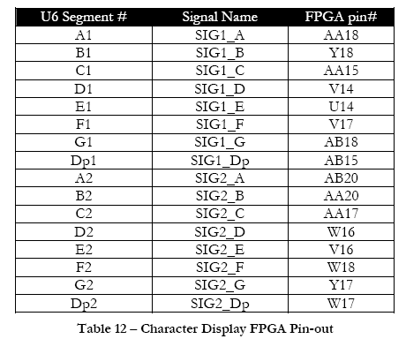
FPGA to design (pin assign)
ucf file :
NET clk LOC = A11 ;
NET rst LOC = Y1 ;
NET push LOC = W2;
NET Ten_R<0> LOC = AA18;
NET Ten_R<1> LOC = Y18;
NET Ten_R<2> LOC = AA15;
NET Ten_R<3> LOC = V14;
NET Ten_R<4> LOC = U14;
NET Ten_R<5> LOC = V17;
NET Ten_R<6> LOC = AB18;
NET Unit_R<0> LOC = AB20;
NET Unit_R<1> LOC = AA20;
NET Unit_R<2> LOC = AA17;
NET Unit_R<3> LOC = W16;
NET Unit_R<4> LOC = V16;
NET Unit_R<5> LOC = W18;
NET Unit_R<6> LOC = Y17;
FPGA Bord Datasheet

Slide 56
HDL Synthesis Report
Advanced HDL Synthesis Report
Macro Statistics
# FSMs : 1
# ROMs : 2
16x7-bit ROM : 2
# Adders/Subtractors : 1
16-bit adder : 1
# Counters : 2
4-bit up counter : 2
# Registers : 19
Flip-Flops : 19

Slide 57
Optimizing FSM/ gray encoding
Optimizing FSM <U_Upluse/state_reg>
on signal <state_reg[1:3]> with gray encoding.
----------------------------------------------------
State | Encoding
----------------------------------------------------
idle | 000
wait_count | 001
inc_dispaly | 011
wait_released_noise | 010
wait_released | 110
----------------------------------------------------

Slide 58
IO & Cell Usage
Design Statistics
# IOs : 17
Cell Usage :
# BELS : 101
# GND : 1
# INV : 1
# LUT1 : 15
# LUT2 : 2
# LUT2_L : 1
# LUT3 : 2
# LUT3_L : 1
# LUT4 : 45
# LUT4_D : 1
# LUT4_L : 1
# MUXCY : 15
# VCC : 1
# XORCY : 15
# FlipFlops/Latches : 27
# FDC : 19
# FDCE : 8
# Clock Buffers : 1
# BUFGP : 1
# IO Buffers : 16
# IBUF : 2
# OBUF : 14

Slide 59
Device utilization summary
Selected Device : 3s1500fg456-4
Number of Slices: 37 out of 13312 0%
Number of Slice Flip Flops: 27 out of 26624 0%
Number of 4 input LUTs: 69 out of 26624 0%
Number of IOs: 17
Number of bonded IOBs: 17 out of 333 5%
Number of GCLKs: 1 out of 8 12%

Slide 60
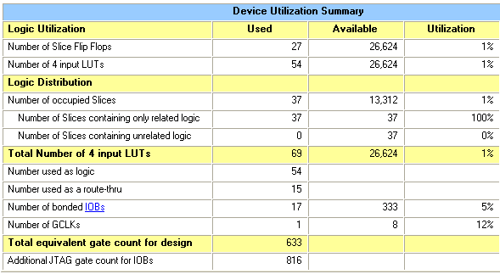
Device utilization summary

Slide 61
Timing Summary
Timing Summary:
---------------
Speed Grade: -4
Minimum period: 6.346ns (Maximum Frequency: 157.580MHz)
Minimum input arrival time before clock: 3.396ns
Maximum output required time after clock: 9.225ns
Maximum combinational path delay: No path found

